Slide 1
Storages

Slide 2

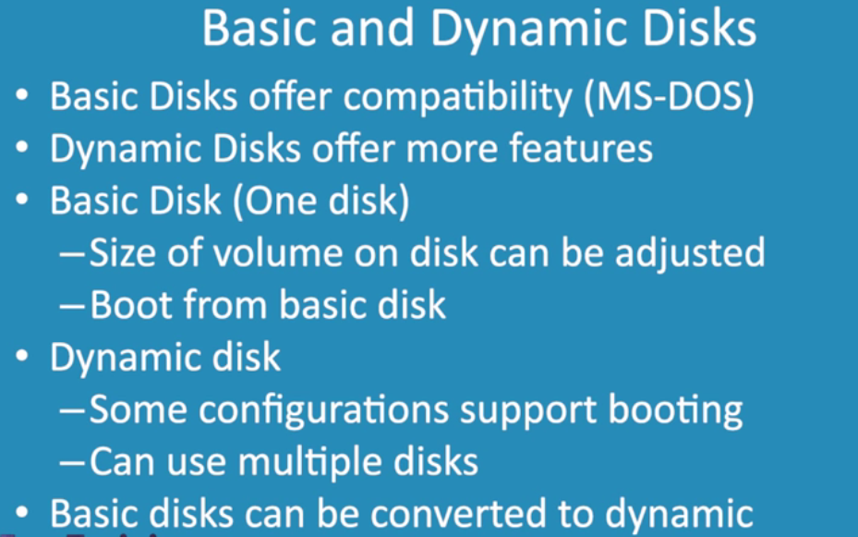

Slide 3
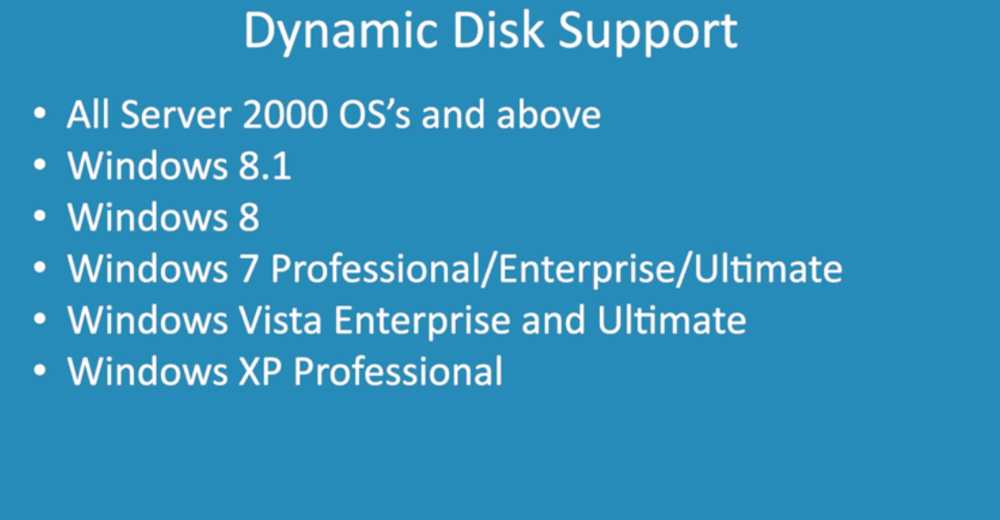

Slide 4
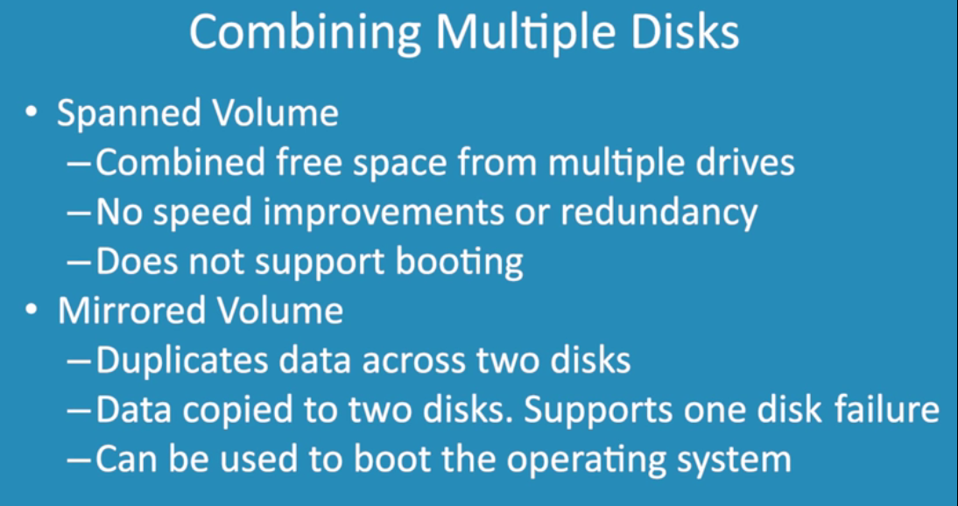

Slide 5
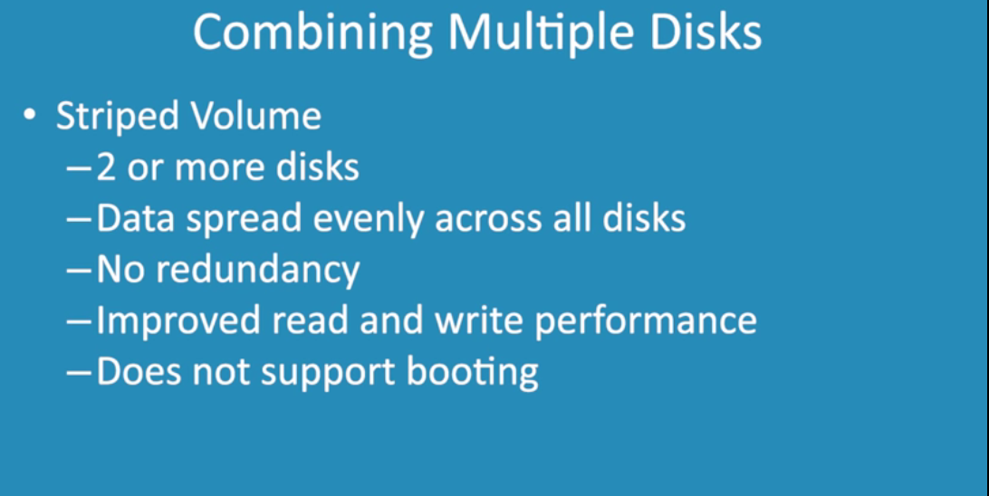

Slide 6
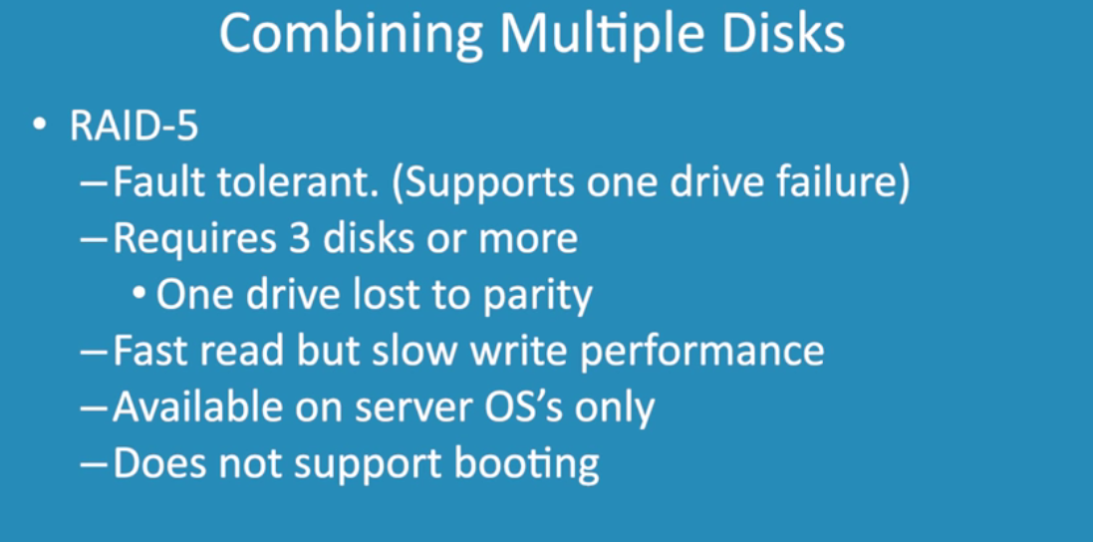

Slide 7
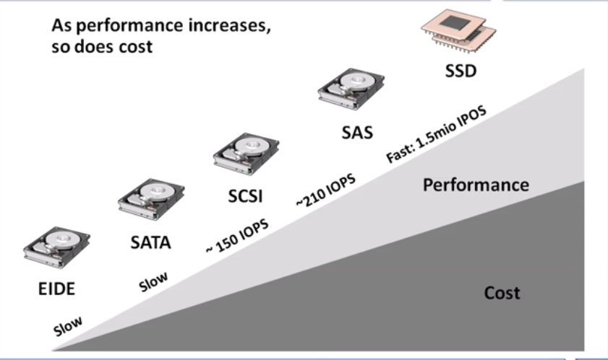
Disk Types & Performance

Slide 8
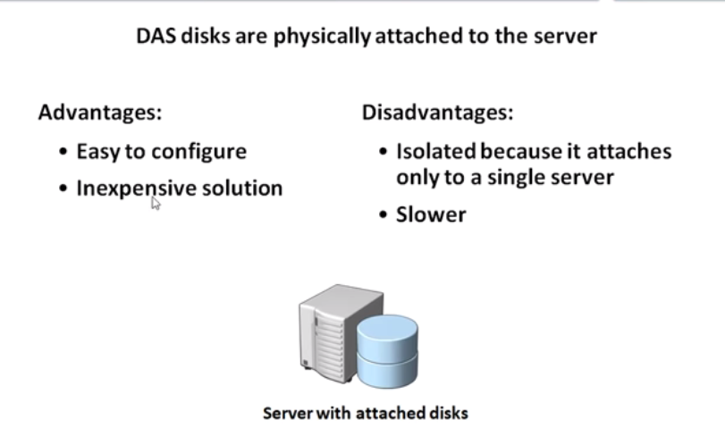
DAS

Slide 9
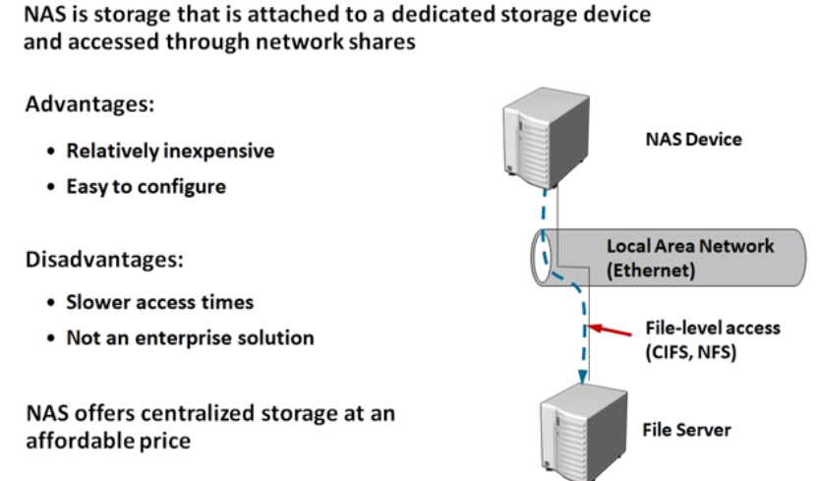
NAS

Slide 10
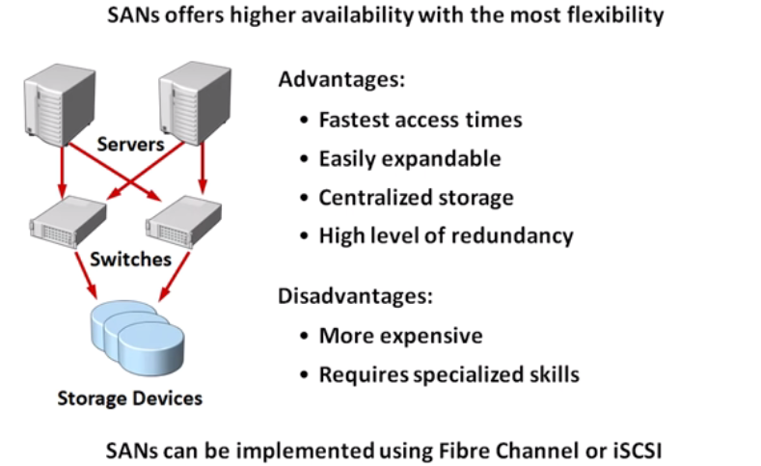
SAN

Slide 11
iSCSI
Inexpensive and simple way to configure connections to remote disk.
A transport layer protocol that works on top of the TCP.
It enables block-level SCSI data transport between the iSCSI initiator and the storage target over TCP/IP networks.
Redundant.
Fault Tolerant.
Highly Available.

Slide 12
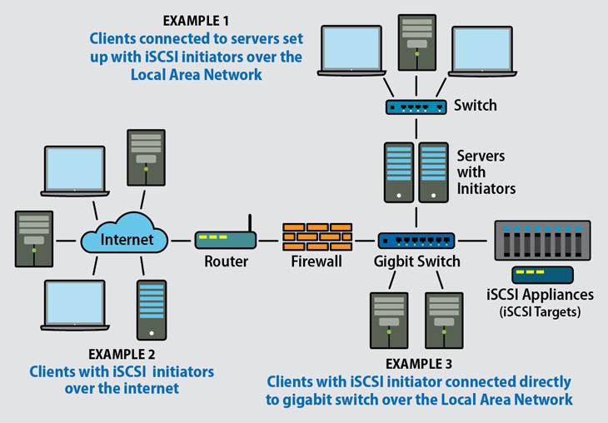
iSCSI

Slide 13
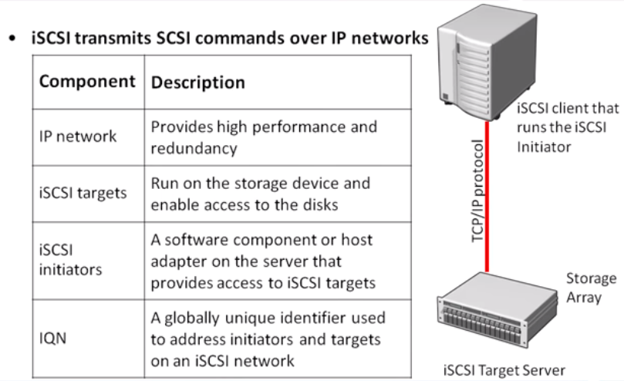
iSCSI

Slide 14
iSCSI Components
iSCSI Initiator:
These technologies package SCSI commands into network packets and direct them to the storage target. The software-based iSCSI initiator is the least expensive of the options, and is often included in the operating system (OS).
HBA: Host-based adapters (HBA) is a hardware device. HBAs are more expensive than software, but higher performance with more functionality.

Slide 15
iSCSI Components
iSCSI target:
iSCSI transports packets across TCP/IP networks. The iSCSI target is the remote storage, which appears to the host system as a local drive. The iSCSI protocol links the hosts and storage over IP networks: LAN, WAN, and Internet.
When the packets arrive at the iSCSI target, the protocol disassembles the packets to present SCSI commands to the operating system. If iSCSI has encrypted the network packet, it decrypts the packet at this stage.

Slide 16
RAID
RAID or Disk Array: The hard disk drives are grouped together using hardware or software and is treated as a single data storage unit.
The data is recorded across multiple hard disk drives in parallel, increasing the access time significantly.

Slide 17
RAID
RAID or Disk Array: The hard disk drives are grouped together using hardware or software and is treated as a single data storage unit.
The data is recorded across multiple hard disk drives in parallel, increasing the access time significantly.
The array of multiple hard disk drives which forms the RAID can also be partitioned and assigned with a file system.

Slide 18
RAID Functions
Striping is the process in which consecutive logical bytes of data is stored per blocks in the consecutive physical disks which forms the array.

Slide 19
RAID Functions
Striping is the process in which consecutive logical bytes of data is stored per blocks in the consecutive physical disks which forms the array.
Mirroring is the process in which the data is written to the same block on two or more physical disks in the array.

Slide 20
RAID Functions
Striping is the process in which consecutive logical bytes of data is stored per blocks in the consecutive physical disks which forms the array.
Mirroring is the process in which the data is written to the same block on two or more physical disks in the array.
Parity Calculation - If there are N number of disks in the RAID array, N-1 consecutive blocks are used for storing data blocks and the Nth block is used for storing the parity.

Slide 21
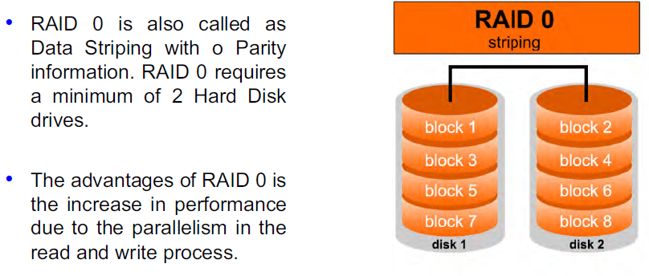
RAID- 0

Slide 22
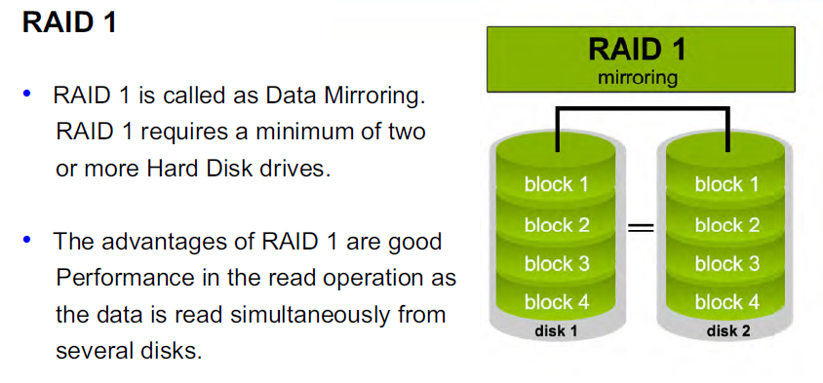
RAID- 1

Slide 23
RAID- 4
RAID 4 is a process of independent, whole Block Access in which the data is stored across the number of disks (N-1) and the other disk acts as a dedicated Parity Drive which stores the parity information.

Slide 24
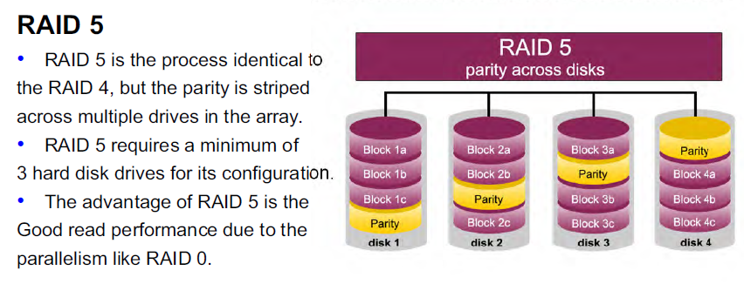
RAID- 5

Slide 25
RAID- 6
Like with RAID 5, read data transactions are very fast.
If two drives fail, you still have access to all data, even while the failed drives are being replaced. So RAID 6 is more secure than RAID 5.

Slide 26
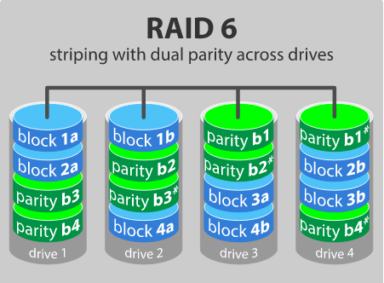
RAID- 6

Slide 27
RAID- 10
If something goes wrong with one of the disks in a RAID 10 configuration, the rebuild time is very fast since all that is needed is copying all the data from the surviving mirror to a new drive.

Slide 28
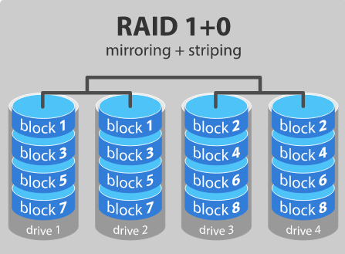
RAID- 10

Slide 29
Storage Virtualization
Uses virtualization concepts which enables better functionality and advanced features within and across storage systems.
Hides the complexity of the SAN by pooling together multiple storage devices to appear as a single storage device.

Slide 30
Types of Storage Virtualization
Host based:
Provided by a server.
Presents a single drive for the applications.
Depends on the software at the server often at the OS level.

Slide 31
Types of Storage Virtualization
Appliance Based:
A hardware appliance is used which sits on the storage network.
Network Based:
Similar to the appliance based except that it works at the switching level.

Slide 32
Advantages of Storage Virtualization
Improvised storage management in an IT environment.

Slide 33
Advantages of Storage Virtualization
Improvised storage management in an IT environment.
Better storage utilization.

Slide 34
Advantages of Storage Virtualization
Improvised storage management in an IT environment.
Better storage utilization.
Less energy usage.

Slide 35
Advantages of Storage Virtualization
Improvised storage management in an IT environment.
Better storage utilization.
Less energy usage.
Increase in loading and backup speed.

Slide 36
Advantages of Storage Virtualization
Improvised storage management in an IT environment.
Better storage utilization.
Less energy usage.
Increase in loading and backup speed.
Cost effective, no need to purchase additional software and hardware.

Slide 37
Disadvantages of Storage Virtualization
More complicated network topology.
SPOF.
The entire network is compromised if any server is infected or breached.

Slide 38
Types of Virtualization
Block Virtualization: The abstraction (separation) of logical storage (partition) from the physical storage so that the partition can be accessed without regard to the physical storage.

Slide 39
Types of Virtualization
File Virtualization: File virtualization eliminates the dependencies between the data accessed at the file level and the physical location where the files are stored.

Slide 40
iSCSI
SCSI :
Family of Interfaces for requesting services from I/O devices
Logical unit- Individual I/O devices
Uses Logical Addressing of data blocks
Two Types : Parallel SCSI, Serial SCSI.

Slide 41
iSCSI
IP based standard for linking data storage devices over a network.
Supports Gigabit Ethernet Interface
Enables location independent data storage and retrieval
Uses existing building blocks (SCSI, TCP)
Point to point direct connections
Transfer SCSI packets

Slide 42
iSCSI
Two types of Devices:
• iSCSI Initiator
• iSCSI Target
iSCSI Initiator:
• Request Commands to execute
• Also called as Client
• Starts the Communication

Slide 43
Cont...
iSCSI Target:
Responds to the request
Also Called as Server
It is device that carry out commands
Endpoint within target executes command called as Logical Unit.
CDB (Command Descriptor Block)
Task – command or linked set of command

Slide 44
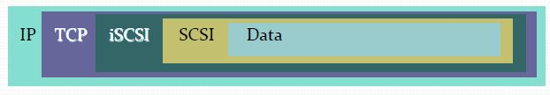
iSCSI Protocol
Based on SCSI
Enables block storage application over TCP/IP networks
It is bi-directional
Monitors and validates I/O operation
IP Packet

Slide 45
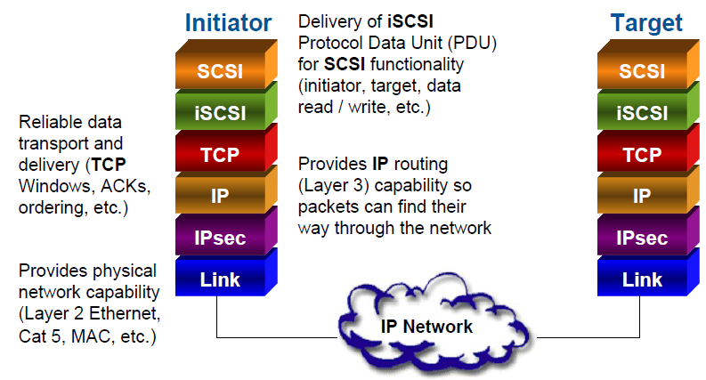

Slide 46
FCIP
Fibre Channel over IP (FCIP) transparently connects FC SAN islands over IP networks.
Encapsulates and tunnels FC frames through an IP network.
Uses TCP for flow control and error handling.
Data encryption and data security measures used in FCIP environments, including IP Security (IPsec) and Internet Key Encryption (IKE).

Slide 47
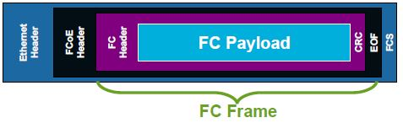
FCoE
FCoE is FC frames encapsulated in Layer 2 Ethernet frames designed to utilize a Lossless Ethernet environment
– Large maximum size of FC requires Ethernet Jumbo Frames
– No TCP, so Lossless environment required
– No IP routing

